Slide 1


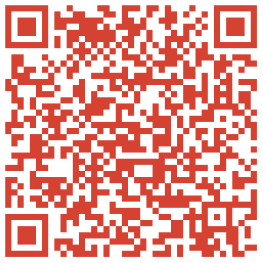
The Bedrock Project
Manifest the American Utopia
Presented by
The Otter Fund

Slide 2

The Bedrock Project
Who does the initial Bedrock Project benefit?
Abused children
Abused spouses
Students/The Homeless
Entrepreneurs/Investors
Minorities/Majorities
Police forces and militaries (decrease of protests)
The Elderly and The Youth (the new poor)
Cities, States, The US and World GDP
All United State's Citizens w/o discrimination

Slide 3

Bedrock Project
The Demystification of Capitalism:
Where does money come from?

Slide 4
Bedrock Project
The Demystification of Capitalism:
Where does money come from?
Money originated in the twelfth century
as a means of trade between regional cultures...
(Business Law; Brown/Sukys; McGraw-Hill/Irwin; 13th Edition; 2013;)
…as it was and will always be easier to carry
some paper and some pressed metal, rather
than a ship, 40 tons of gold, or even acres of land.
Therefore:
Capitalism is a courtesy of trade.

Slide 5
Bedrock Project
The Demystification of Capitalism:
Where does new money come from?
Presently, since 1971, capital is created with interest and when the Federal Reserve buys bonds from banks.
Capital is then distributed via loans, through banks. These loans possess terms and financial discriminations. All discrimination in a society is an urgent social problem. Discrimination leads to resentment, frustration,
and genocides, by minority OR majority.
(http://www.dummies.com/how-to/content/where-does-money-come-from.html; 2014)

Slide 6
Abstract:
The Perpetual Dream
To remove the threat of death in the US system of government.
To liberate all victims of someone else's capital; and therefore, someone's personal pride or control.
If hope never ends, then the “rich” and the “poor” never have a reason to “give-up.”

Slide 7
Misconception:
There is an implied notion from the middle-class unto the at-risk class in all societies; which applies stigma to lives without income generation, which includes intellectuals, scientists, visionaries, and artists.
ECONOMIC STABILITY: With a bedrock of capital which renews in an annual lump sum, individuals will in fact positively take-up the American Dream with greater hope and drive, instead of having to resort to desperate measures or crime upon others.
Citizens will be attracted to improved conditions in lower-level jobs and strive toward financial empowerment to be
as truly equal Citizens able to choose best.

Slide 8
Bedrock Project
A Sound Foundation
Important factor:
Regardless of religious or philosophical view, the huge majority of the world's population have faith in the value of these paper representations of ancient resources. So much is this faith ingrained in the idea of trade that “money” is accepted in trade for almost anything...and for everything if we include the illegal-markets.

Slide 9
Bedrock Project
A Sound Foundation
“Compound interest is the
eighth wonder of the world.”
― Albert Einstein

Slide 10
Factors
There is an essential link between “money” and math.
Money responds to math only because there are many many pieces of paper.
Money is only the “root of evil” when one person can totally take advantage of another person regardless of age that is dependent on another human's financial resources.

Slide 11
What is poverty?
The Census Bureau’s poverty line for 2010 was $17,374 for a family of three and $22,314 for a family of four.
(http://www.cbpp.org/files/11-15-11sfp.pdf; 2011)
Finances are the only qualifier of poverty.
The population of the United States is
estimated at only 313,900,000 (million) people.
(United States Census Bureau; 2012)

Slide 12
The Bedrock Project
The Math
313.9 million people times $17,374 is $5,453,698,600,000 (trillion), annually, to end all extreme poverty in the United States of America.
Therefore the optimally funded investment vehicle would generate 5.5 trillion dollars annually.

Slide 13
Risk and Goal
The overall goal of this act is to remove the blight of discrimination and the illusions of supremacy that arise out of the phenomena of capitalistic (paper) trade.
It is in a real effort to end discrimination and thereby eliminate the justifications to police instead of administer a US Citizen's right to economic security and freedom, even for the youth, and even the children of the wealthy, and to protect all Citizen’s from unreasonable inflation with the Project of large numbers.

Slide 14
Future Risks to Implementation
If the fund is controlled by Congress after it is began, then the fund is open to manipulation and destruction.
Therefore, it must have an independent board and a privatized foundation.
ALTERNATIVES: A privately ran fund, perhaps by one of the great pre-existing institutions began by great former Presidents (ex: The Carter Foundation) is an appropriate administer of the funds to maintain integrity and to avoid any attempts to corrupt the program...which would result in; retaining social stratification, starvation, and abuse.

Slide 15
Micro-Budget Fiscal Alternatives to the Full Solution
The Bedrock Program can begin with a fund of only five billion dollars, with initial enrollment beginning as need based, possibly determined by the number of years on State and federal sponsored welfare programs. Initial annual enrollment would be roughly 46,000 people; with enrollment compounding annually along with the interest on the fund.
In this micro-implementation of the concept of Bedrock Project/Principal the fund would be able to enroll members after one year of existence.
Money itself is non-discriminatory.

Slide 16
Linguistic Goals
To change the phrase in the American speech pattern, from, “Money is the root of all evil,” to, “Money is the root of all goodness.”
Money is also the root of all freedom. (Stephan Pacheco; Bedrock Project Presentation; just now)
Americans already believe,
“Money is the solution to
all of their [life-threatening]
problems.

Slide 17
What will the future look like with this Social Bedrock?
Happy, and with a vast reduction in social tension in public areas.
A country founded on high abstract ideals becomes what it always dreamed, with a populace that is Equal and Free and together by Choice.
The end of revolutions to redistribute wealth.
The end of the “supremacy” concept,
as an increased percentage of people
can willingly pursue betterment to thrive.

Slide 18
Why we need this now:
Capital is becoming more and more controlled by special interest groups, and individuals motivated by personal strategy and gain. Therefore, a government response is likely required because government is best positioned to remove prejudice.
We must end the belief that suffering is deserved, just because suffering existed before. We do not all belong to religions that condone such an idea; therefore, it must be removed from the implementation
of government.

Slide 19
Why we need this now:
Capital is becoming more and more controlled by special interest groups, and individuals motivated by personal strategy and gain. Therefore, a government response is likely required because government is best positioned to remove prejudice.
We must end the belief that suffering is deserved, just because suffering existed before. We do not all belong to religions that condone such an idea; therefore, it must be removed from the implementation of government.

Slide 20
Restatement of Urgency
Capitalism has a natural expiration date. This expiration date will occur when there are no further minorities to employ at a discounted rate. Relying on some of the random youth for this is beyond the social contract which allows and is a result of capitalism.

Slide 21
Threats to the Economic Future:
The possible over abundance of human-made base resources.
A World Without the Need for Suppliers:
A true future risk to the nature of our random economy, which may seem unbelievable, is that the human species may well develop the ability to “replicate” or assemble base resources, even human organs, without the planet of origin, which would completely devalue all resources. Without independence promoting programs, like this one, we can all become slaves to any source of anything.

Slide 22
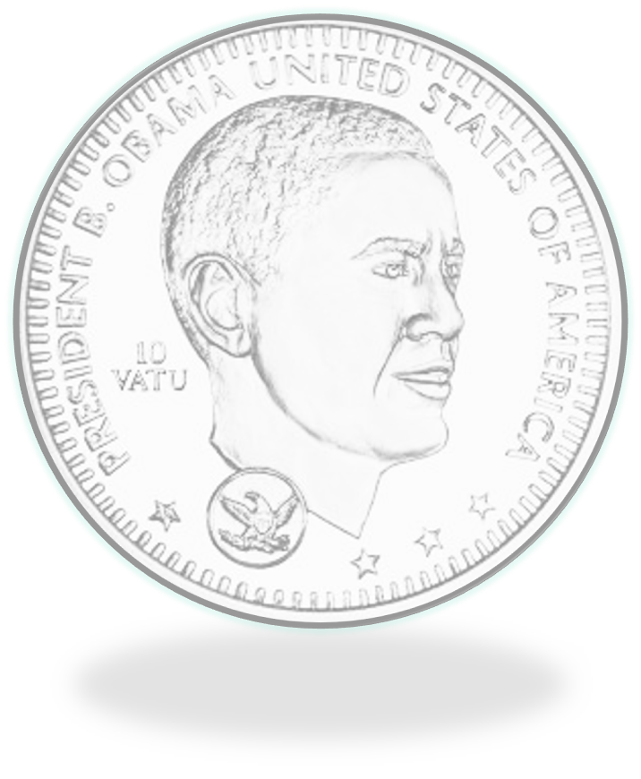
The Ultimate Solution
A President of the United States of America mints a $5,000,000,000,000 (trillion) dollar coin to establish the privately-protected fund that will end the source of a massive amount of human suffering.
…and this will hand each individual the keys to utopia.

Slide 23
Personal Statement of Author
“The only fear we have to fear is terror.”
Opponents of this program don't want guaranteed fortune, and we can struggle and compete for that (too make what people want), but we want our lives and freedom backed to the goal of guaranteed by the government...money is all it takes and money is now fabricated by governments. Or else, our life is not guaranteed, nor is our Freedom...and leaves a state of terror for ALL people to fear, which leaves the constant potential for human violence.
Family is not an appropriate expected option for stability of any kind, because it cannot be guaranteed. In fact, it is common for American parents that would kill to protect their kids to simultaneously let them
die “deservedly” with death by economy or passively by isolation and economy.

Slide 24
Please support :
The Otter Fund
“Devoted to the annihilation of severe poverty in the US.”
Click this link: https://secure.actblue.com/donate/the-otter-fund---unlimited-1

Slide 25
Additional References
- Scott, Marshall; Oxford Dictionary of Sociology; Oxford
University Press; 2009;
- Cantarow; Moving the Mountain; The Feminist Press; 1980;
- Rosenberg; Growing Up Feeling Good; Lima Bean Press;
2002;
- Thomson; Discrimination; The Gale Group; 2008

Slide 26
Please support The Otter Fund
“Devoted to the annihilation of severe poverty in the US.”
Click this link: https://secure.actblue.com/donate/the-otter-fund---unlimited-1

Slide 27
Please support The Otter Fund
“Devoted to the annihilation of severe poverty in the US.”
Click this link: https://secure.actblue.com/donate/the-otter-fund---unlimited-1

Slide 28
Please support The Otter Fund
“Devoted to the annihilation of severe poverty in the US.”
Click this link: https://secure.actblue.com/donate/the-otter-fund---unlimited-1

